Slide 1
Course Page POC
-By Noah Beilke, Logan Morgan, Collin Renner, Matt Giannola
Notes:
Everyone introduces themselves

Slide 2
Team Members:
Team Leader - Matt Giannola
Web Developer - Noah Beilke
Database Developer - Collin Renner
Project Coordinator - Logan Morgan
Notes:
Loganf

Slide 3
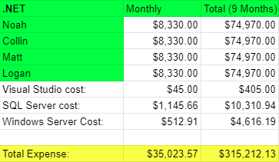
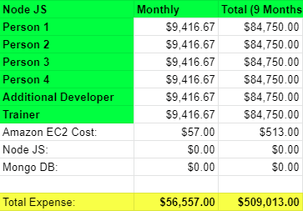
Cost Analysis Overview
Notes:
Logan

Slide 4
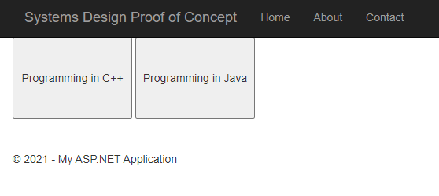
Proof of Concept
Notes:
Noah

Slide 5

Proof of Concept
Notes:
Noah

Slide 6

Proof of Concept
Notes:
Noah

Slide 7
Next Steps
Test for courses Implementation: 1 Month
More information to display on course page: 1 Weeks
Load courses that a user is enrolled in: 1 Month
Develop database to help with previous steps: 1 Month
Notes:
Collin

Slide 8
Demo
Notes:
Noah

